Slide 1
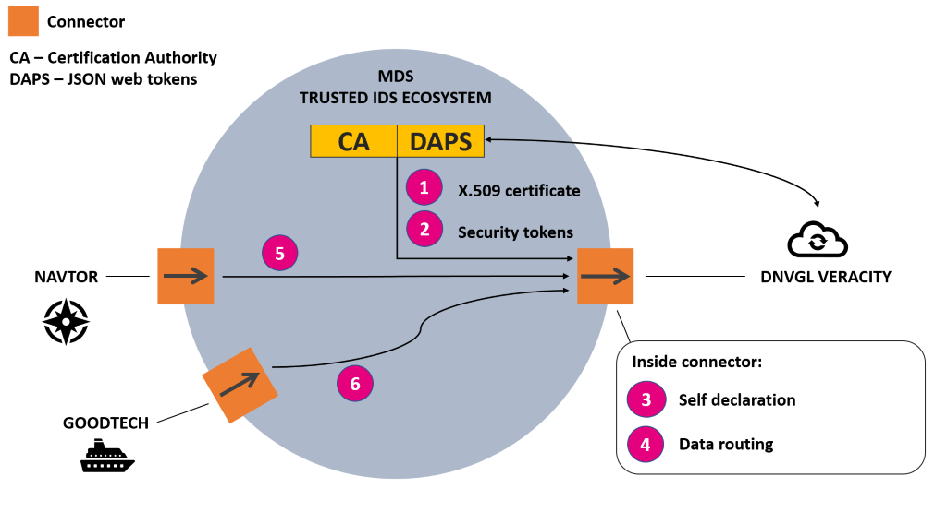

Slide 2
Maritime Data Space Architecture
Consumer space
Provider space (SINTEF Digital test environment)
External
REST API
GET
/navtor/data
MDS Service Registry
Provide
credentials
in req header
Route request to service
Validate tokens for each request
1
MDS Gateway
5
MDS Load Balancer
DNVGL Veracity Connector
4
7
3
2
Response
Generate
token
Validate
credentials
6
SOAP
API
MDS Authentication
(JWT)
Navtor
Connector
NavTracker
Navigational data
REST
API
Neuron
(Data Bridge)
Ship engine data
NEW components Q2 2020:
Certificate Authority
Data Usage Control
Neuron
Connector
MDS ecosystem component
Connector

